Slide 1
K-Nearest Neighbors

Slide 2
Outline
Why do we need KNN?
What is KNN?
How do we choose the factor “K”?
When do we use KNN?
How does the KNN Algorithm work?
Use Case: Predict Diabetes

Slide 3
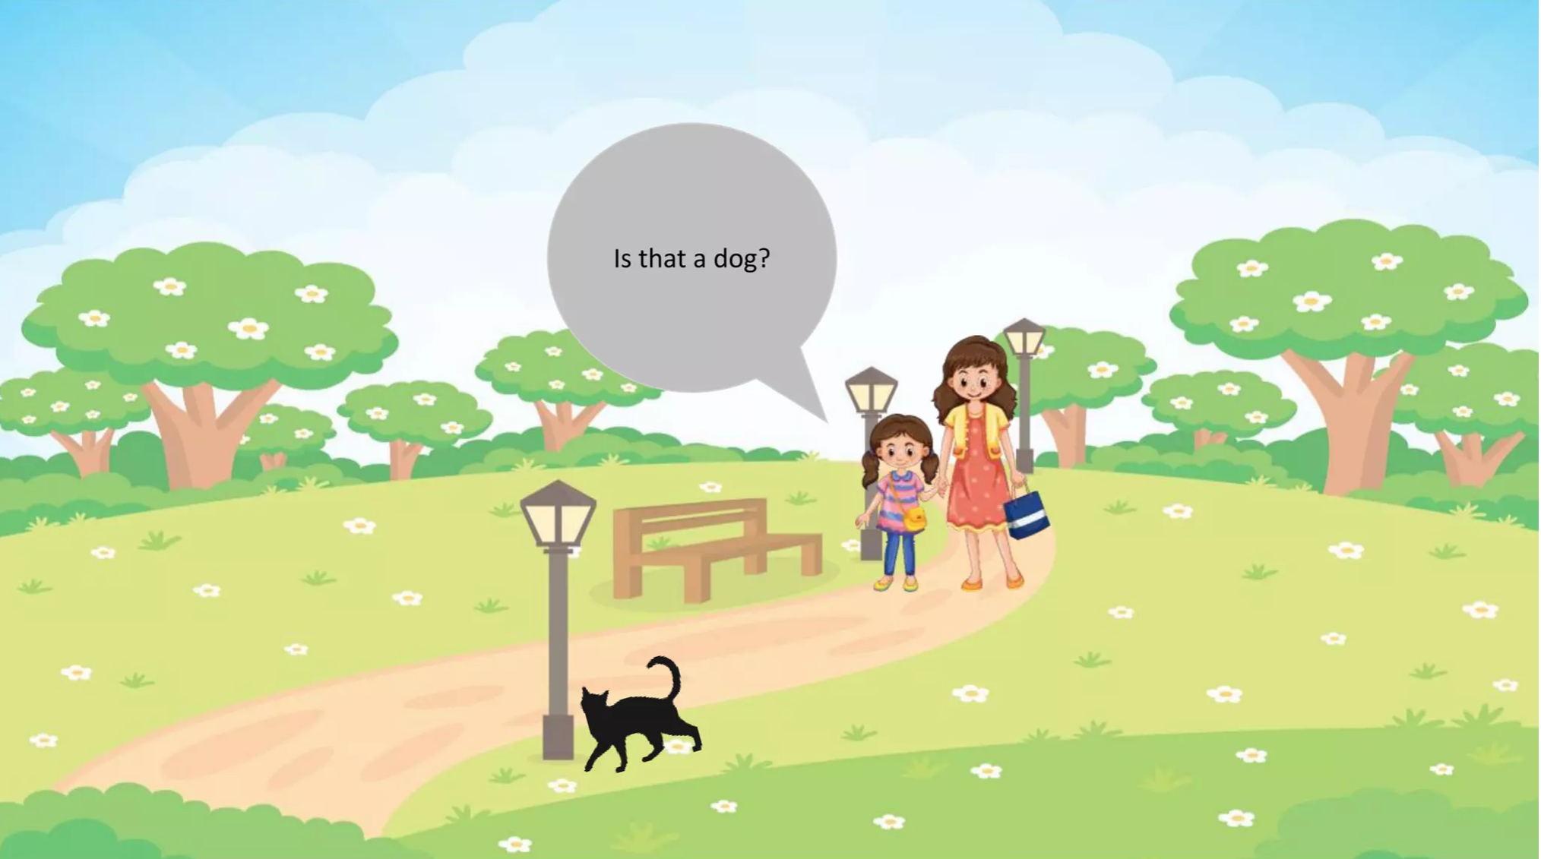

Slide 4
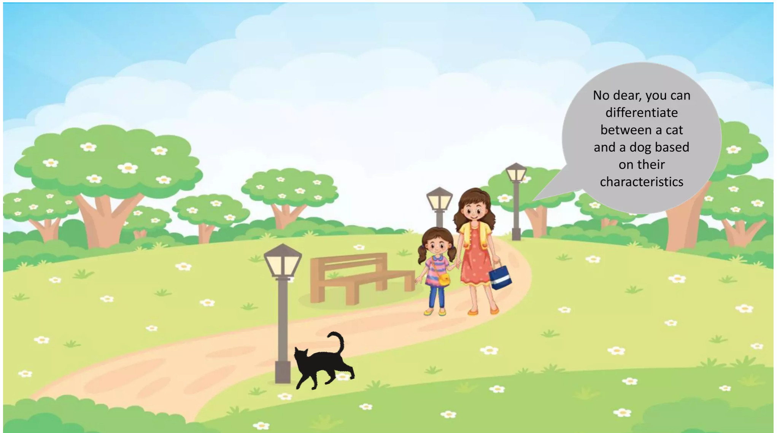

Slide 5
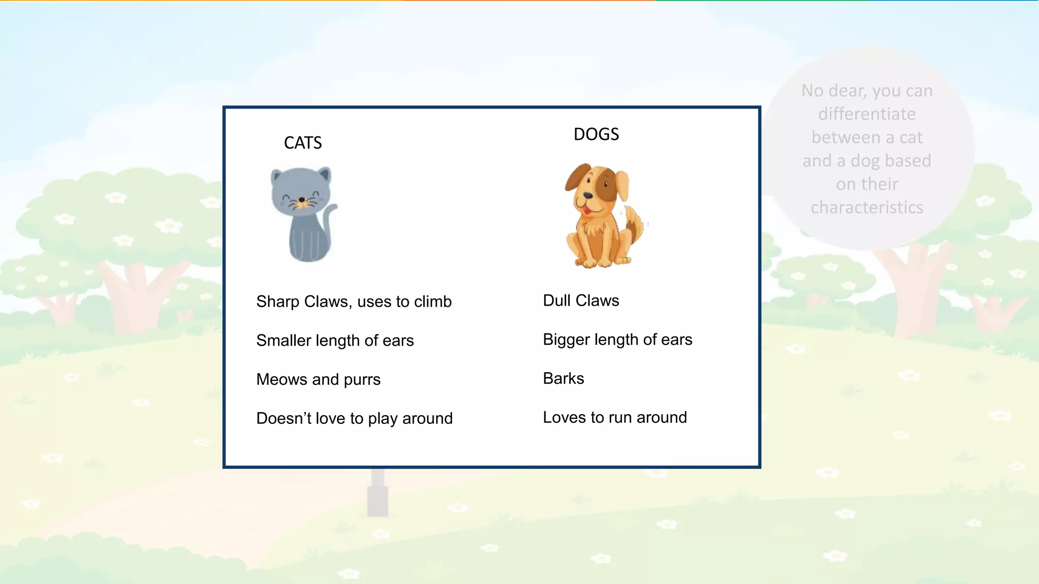

Slide 6
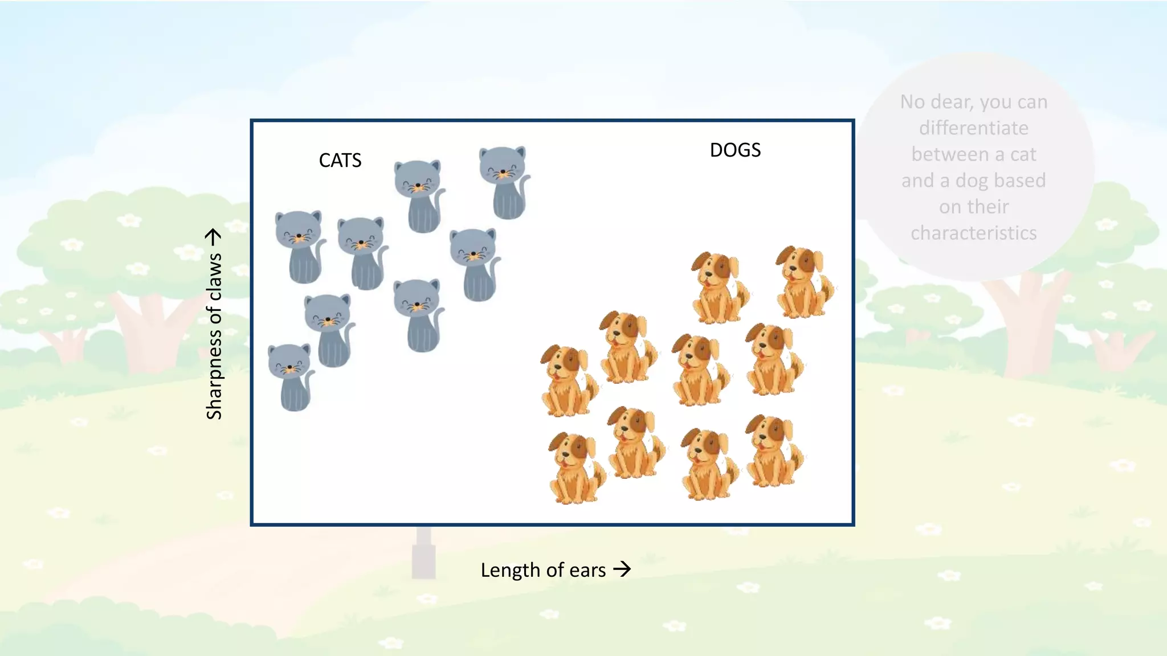

Slide 7
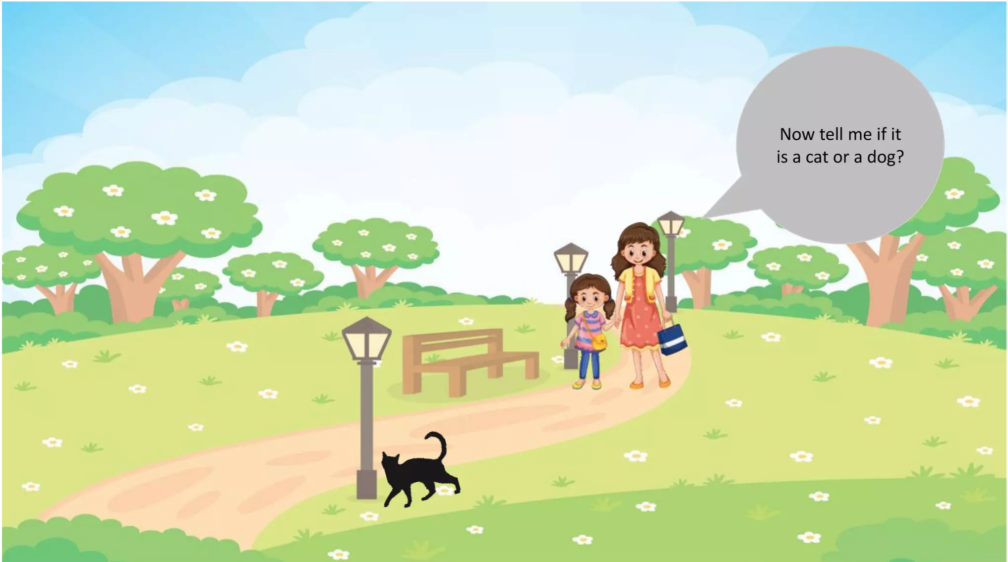

Slide 8
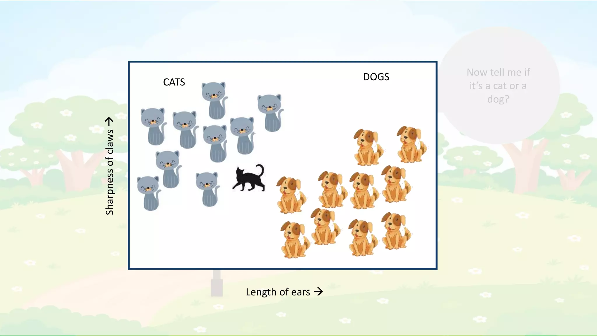

Slide 9
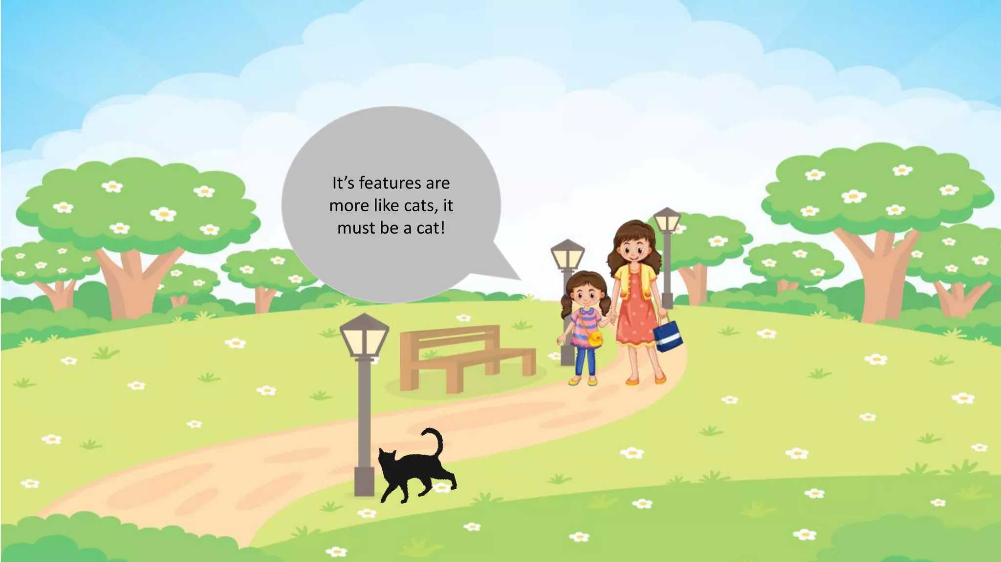

Slide 10
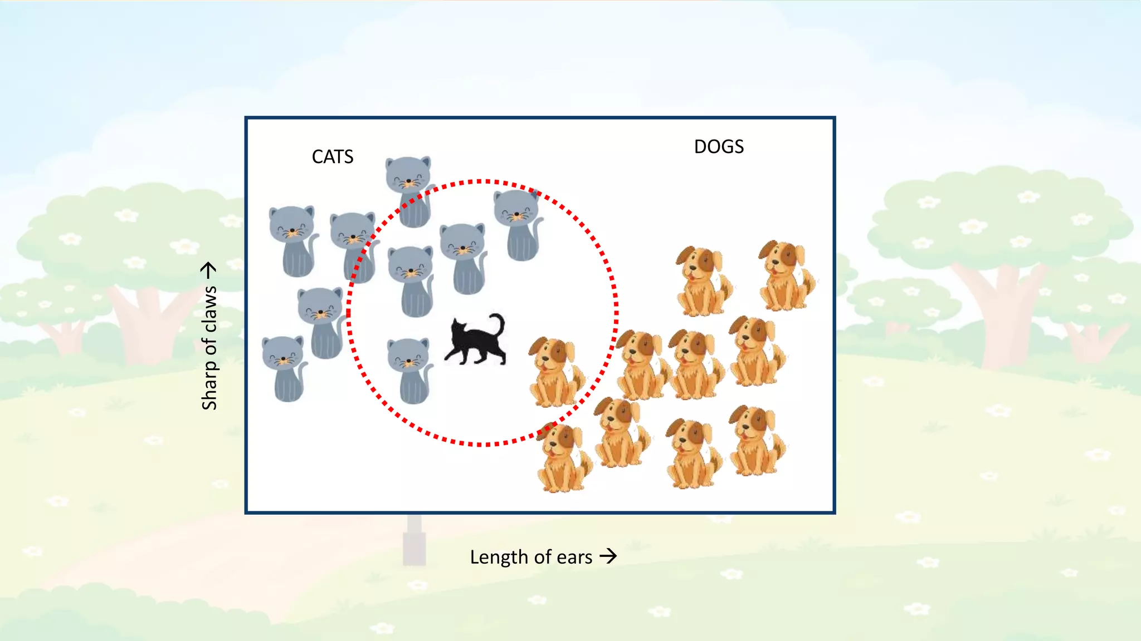

Slide 11
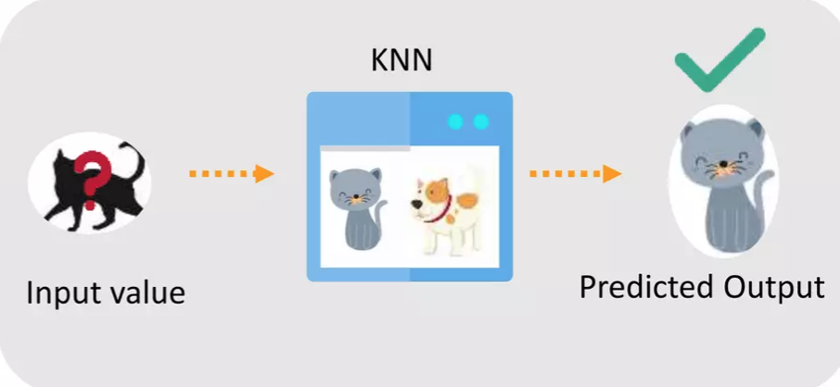
Because KNN is based on feature similarity, we can do classification using k-NN

Slide 12

Outline
Why do we need KNN?
What is KNN?
How do we choose the factor “K”?
When do we use KNN?
How does the KNN Algorithm work?
Use Case: Predict Diabetes

Slide 13
What is k-NN?
KNN or k-Nearest Neighbor is a supervised machine learning algorithm mostly used for classification.
It classifies a data point based on how its neighbors are classified

Slide 14
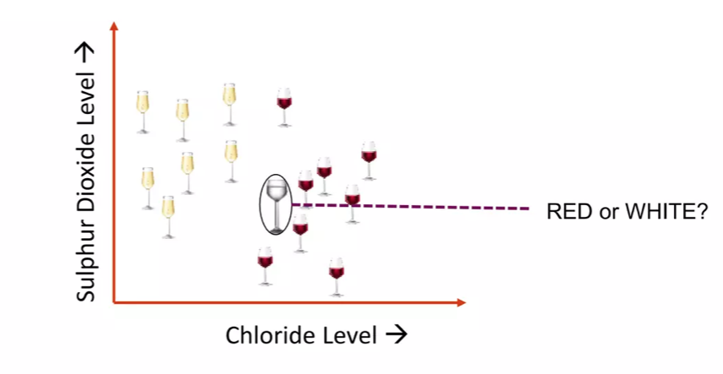
What is k-NN?
k-NN stores all available cases and classifies new cases based on a similarity measure

Slide 15
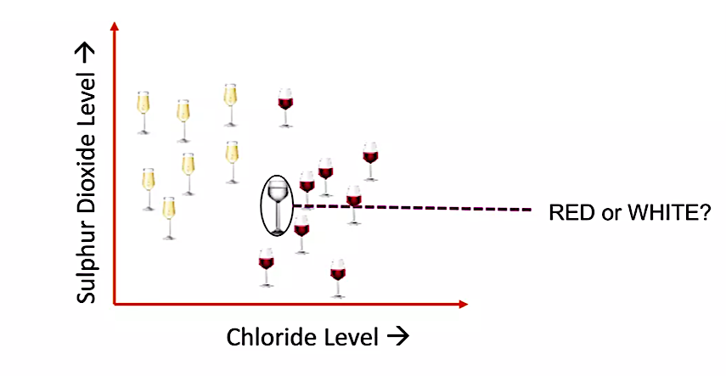

Slide 16
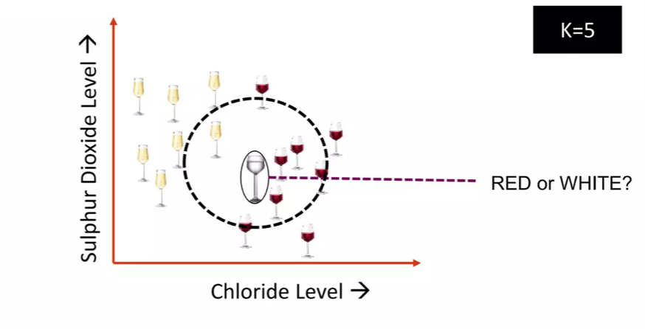
What is k-NN?
K in KNN is a parameter that refers to the number of nearest neighbors to include in the majority voting process

Slide 17
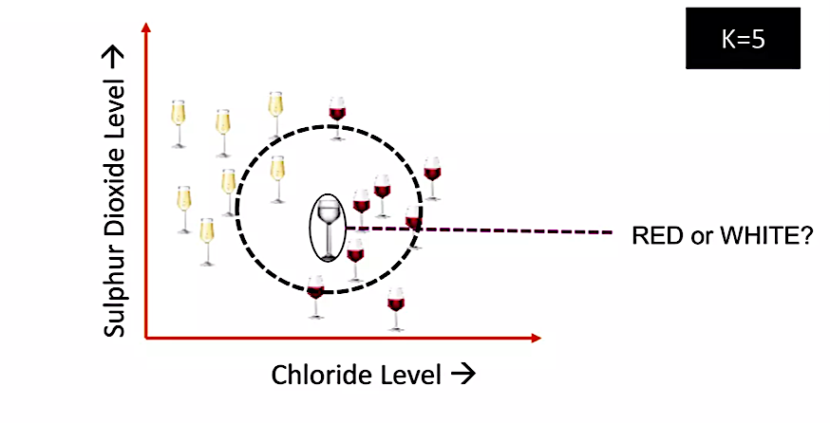

Slide 18
What is k-NN?
A data point is classified by majority votes from its 5 nearest neighbors

Slide 19
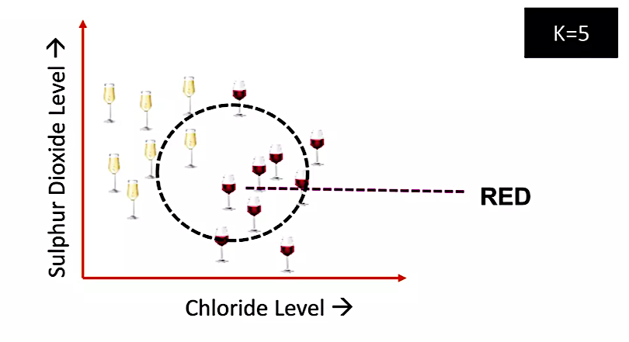

Slide 20
Outline
Why do we need KNN?
What is KNN?
How do we choose the factor “K”?
When do we use KNN?
How does the KNN Algorithm work?
Use Case: Predict Diabetes

Slide 21
How do we choose ”K”?
KNN is based on feature similarity.
Choosing the right ”K” is a process of parameter tuning and it is important for better accuracy

Slide 22

$$k = 3$$
?
When $k$ = 3, we can classify the new data point as

Slide 23
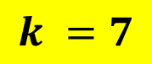
$$k =7$$
$$k = 3$$
?
But when $k$ = 7, we can classify the new data point as

Slide 24
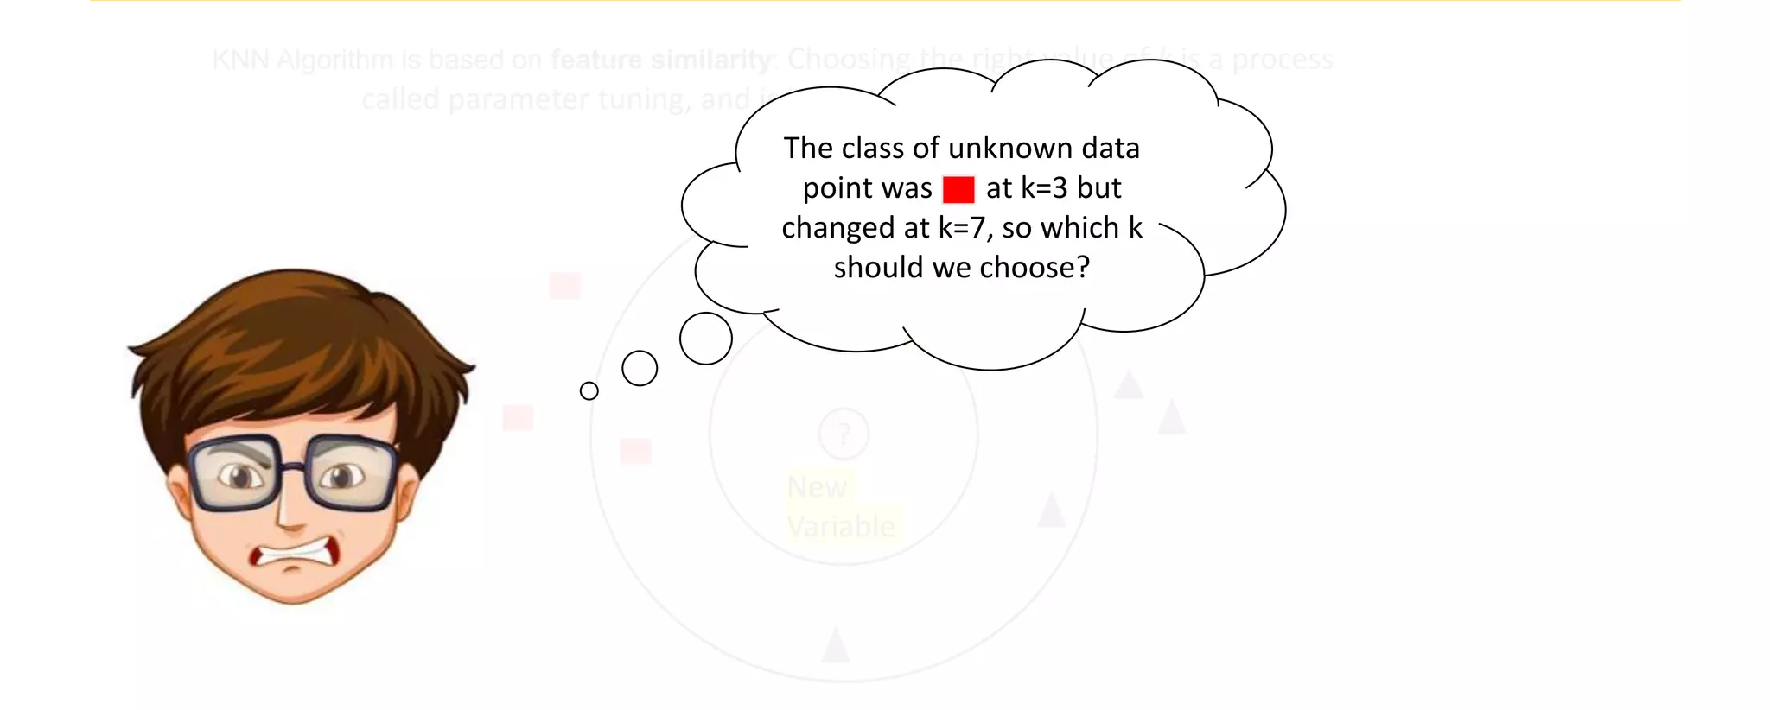
How do we choose “K”?

Slide 25
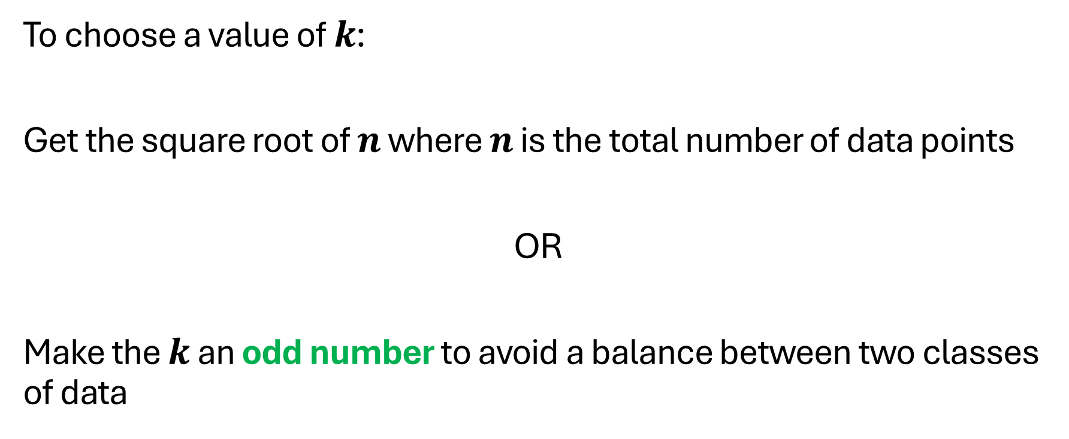
How do we choose “K”?
To choose a value of $k$:
Get the square root of $n$ where $n$ is the total number of data points
OR
Make the $k$ an odd number to avoid a balance between two classes of data

Slide 26
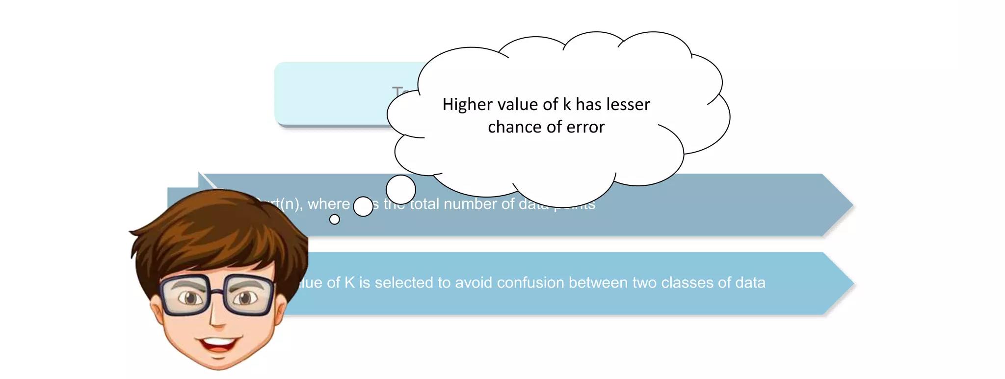
How do we choose “K”?

Slide 27
Outline
Why do we need KNN?
What is KNN?
How do we choose the factor “K”?
When do we use KNN?
How does the KNN Algorithm work?
Use Case: Predict Diabetes

Slide 28
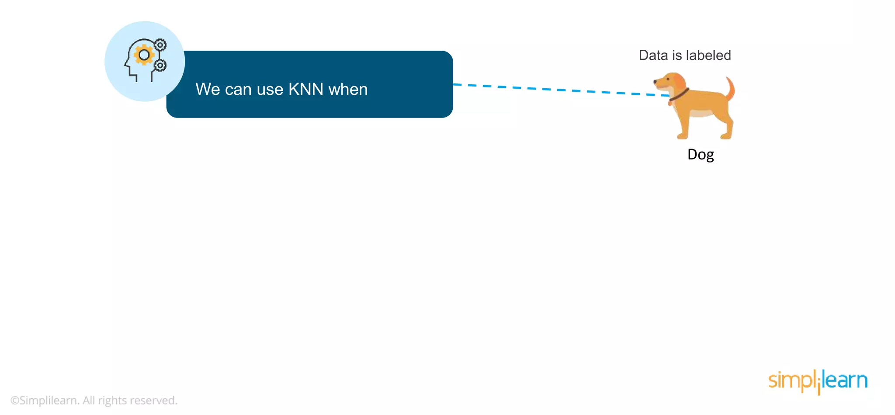

Slide 29
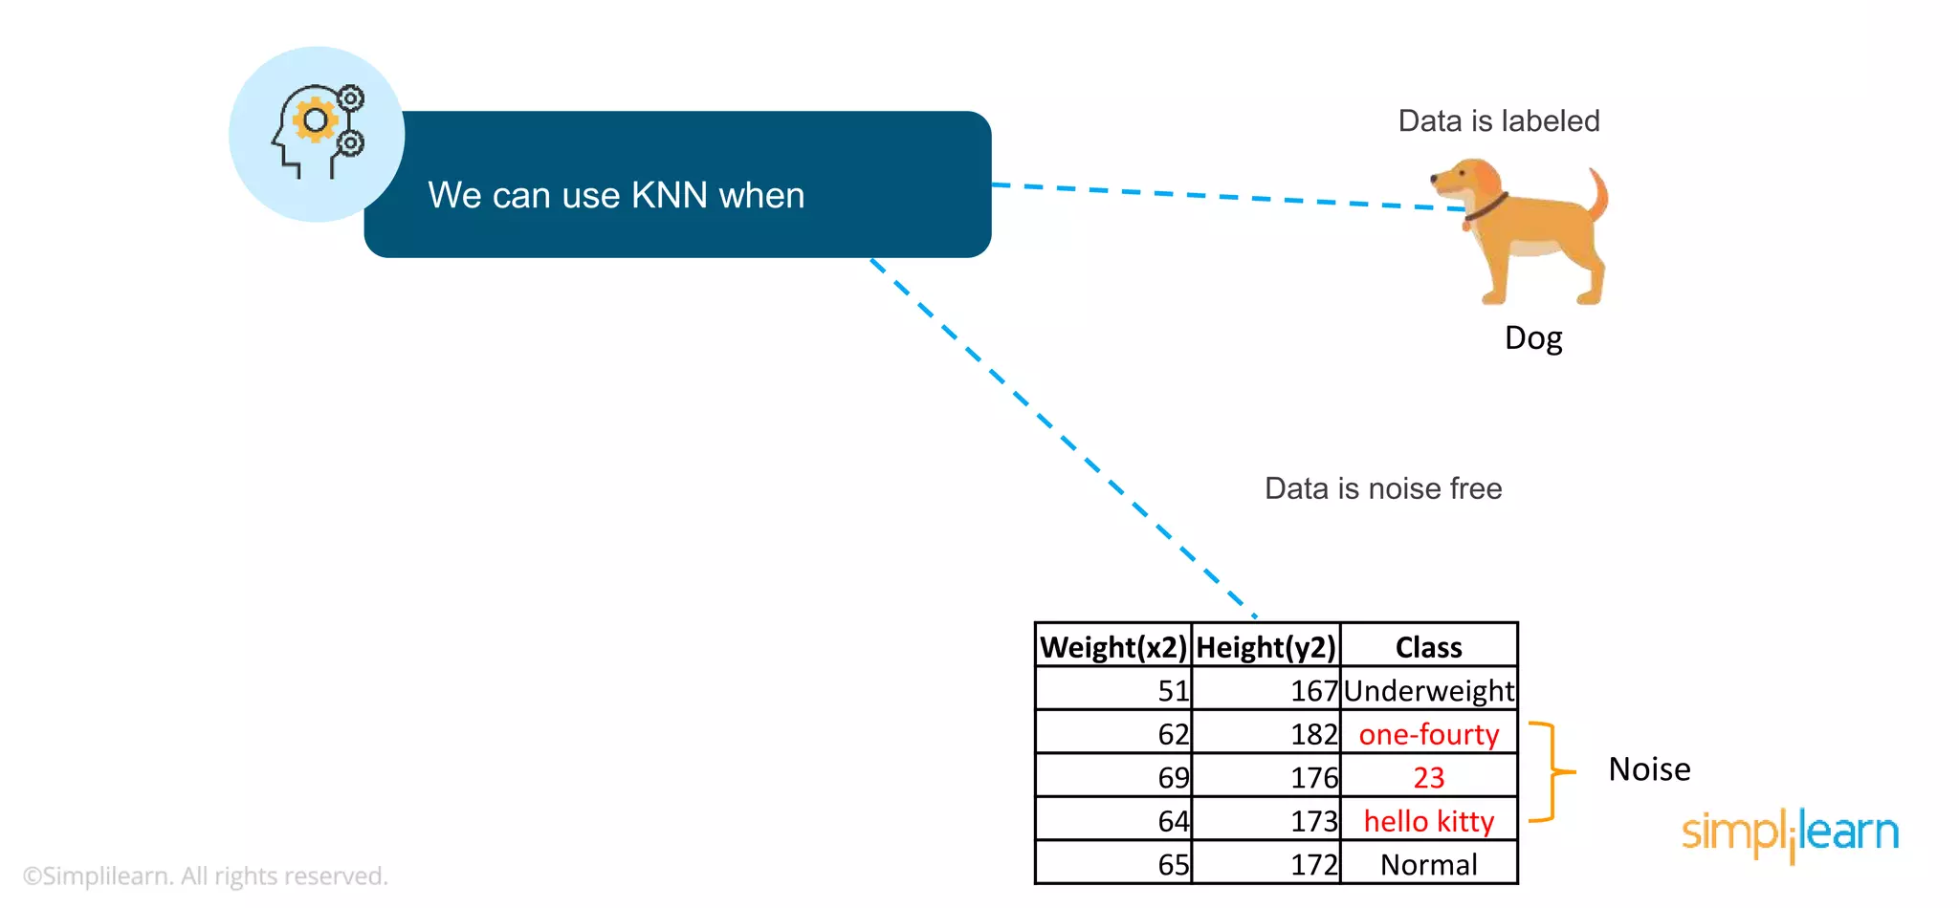

Slide 30
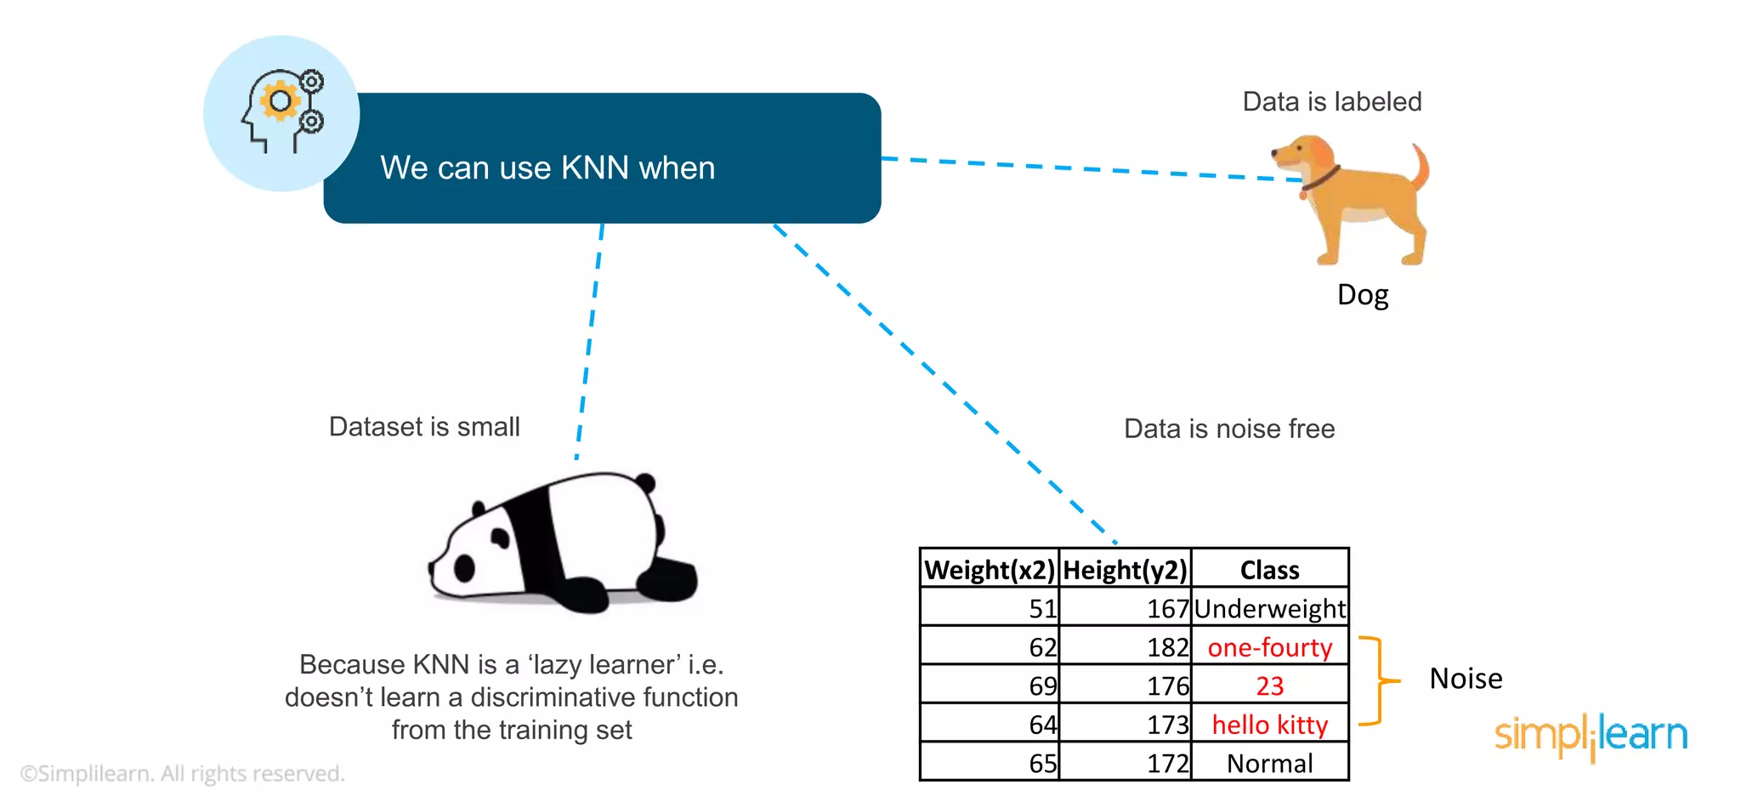

Slide 31
Outline
Why do we need KNN?
What is KNN?
How do we choose the factor “K”?
When do we use KNN?
How does the KNN Algorithm work?
Use Case: Predict Diabetes

Slide 32
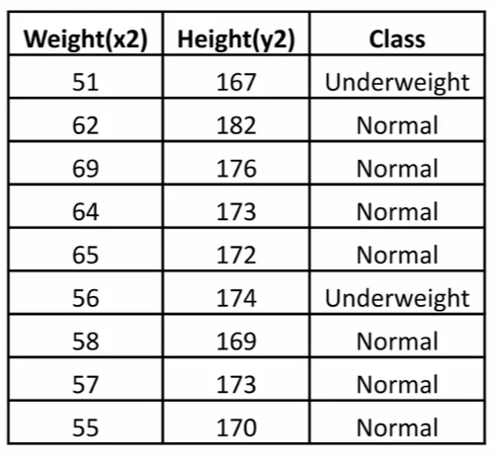
How does k-NN work?
Consider the dataset having two variables: height(cm) and weight(kg) and each datapoint is classified as Normal or Underweight

Slide 33
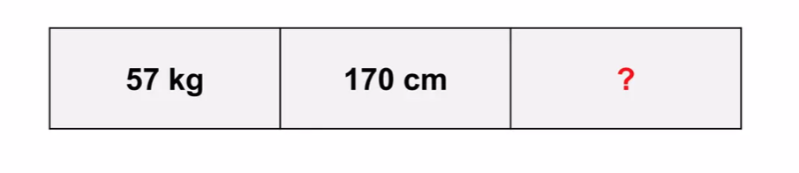
How does k-NN work?
Assuming we do not know how to calculate the body mass index (BMI), we need to classify this unseen data as Normal or Underweight

Slide 34
How does k-NN work?
KNN finds the nearest neighbor by calculating the Euclidean distance

Slide 35
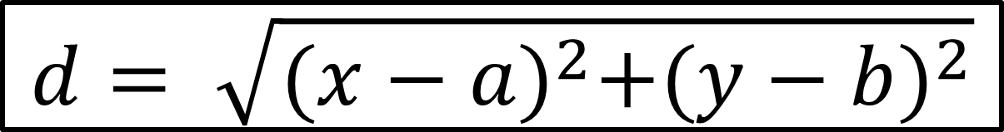
How does k-NN work?
k-NN uses Euclidean distance formula, to calculate the distance between two data points
$$d= \sqrt{{(x−a)}^{2}+{(y−b)}^{2}}$$

Slide 36
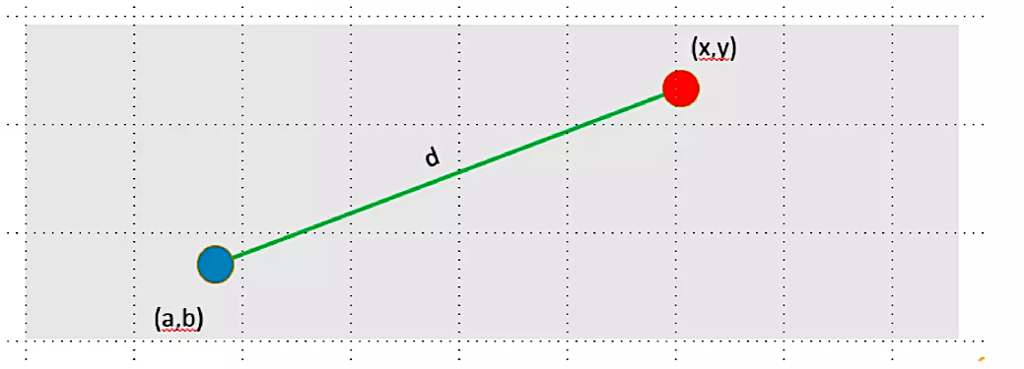
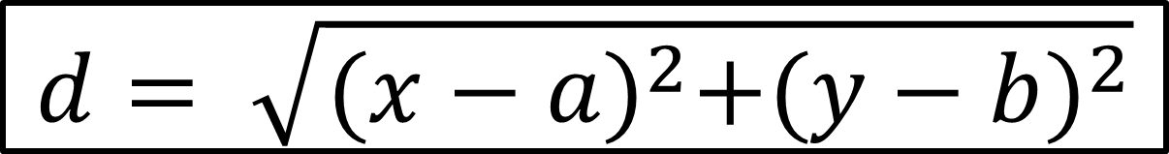
$$d= \sqrt{{(x−a)}^{2}+{(y−b)}^{2}}$$

Slide 38
d1
d1 = √ (170-167)²- (57-51)²
d1 = 6.7

Slide 39
d1
d2 = √ (170-182)²- (57-62)²
d2 = 13

Slide 40
d1
d3 = √ (170-176)²- (57-69)²
d3 = 13.4

Slide 41
d1 = √ (170-167)²- (57-51)²
d1 = 6.7
d2 = √ (170-182)²- (57-62)²
d2 = 13
d1
d3 = √ (170-176)²- (57-69)²
d3 = 13.4
Similarly, we calculate the Euclidean distance of the unknown data point from all points in the dataset

Slide 42
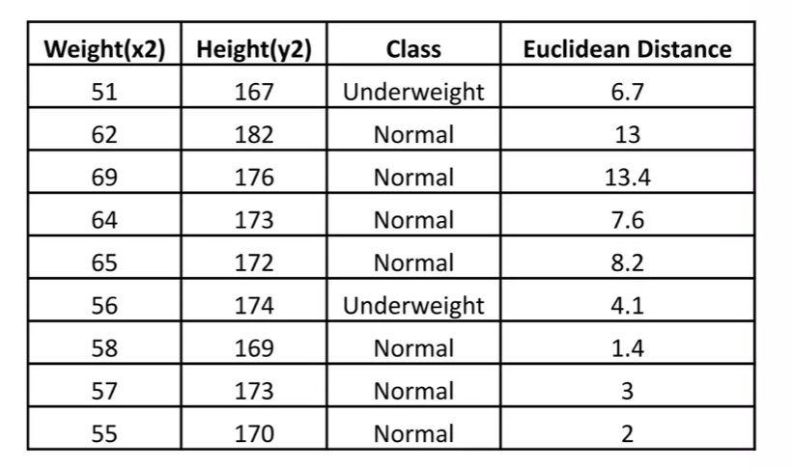
How does k-NN work?
After we calculate the Euclidean distance of the unknown datapoint from all the data points, we get…

Slide 43
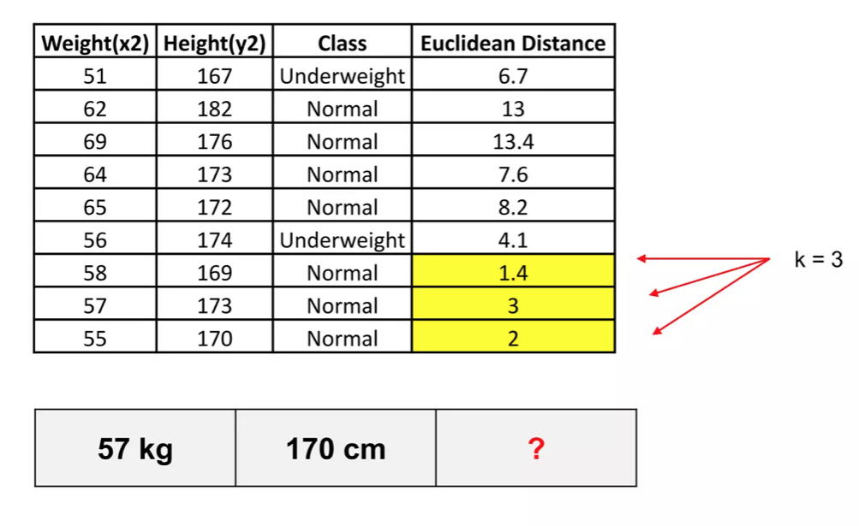
How does k-NN work?
Let us calculate the nearest neighbor at k=3

Slide 45
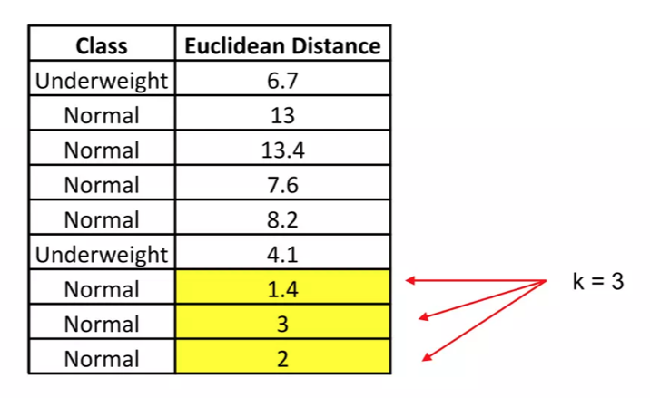
The majority of its nearest neighbors are Normal.
Hence, having a weight of 57 kg and a height of 170 cm is classified as Normal
57 kg | 170 cm | Normal

Slide 46
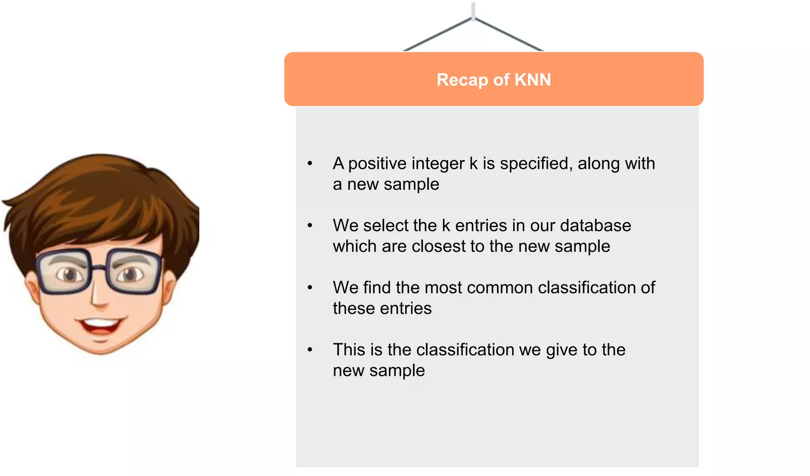

Slide 47
Outline
Why do we need KNN?
What is KNN?
How do we choose the factor “K”?
When do we use KNN?
How does the KNN Algorithm work?
Use Case: Predict Diabetes

Slide 48
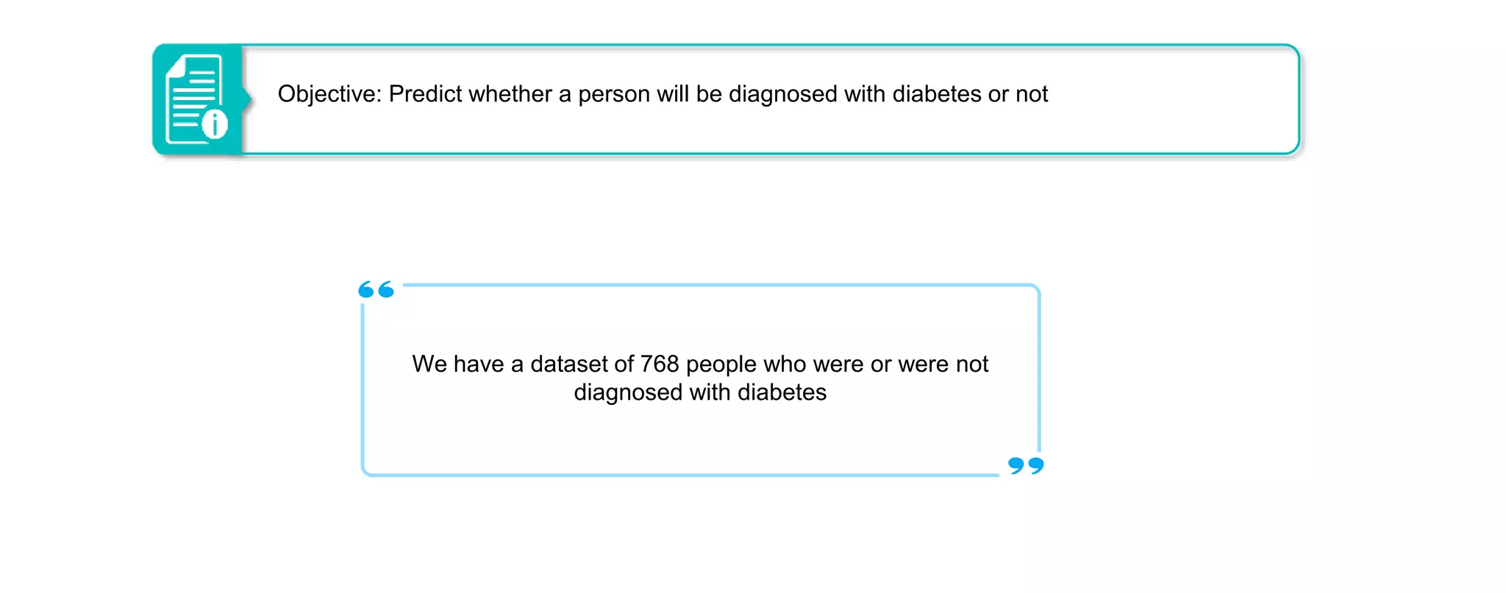

Slide 49
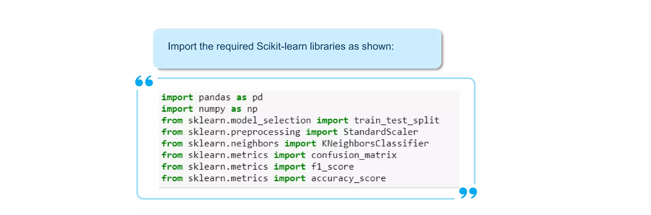

Slide 50
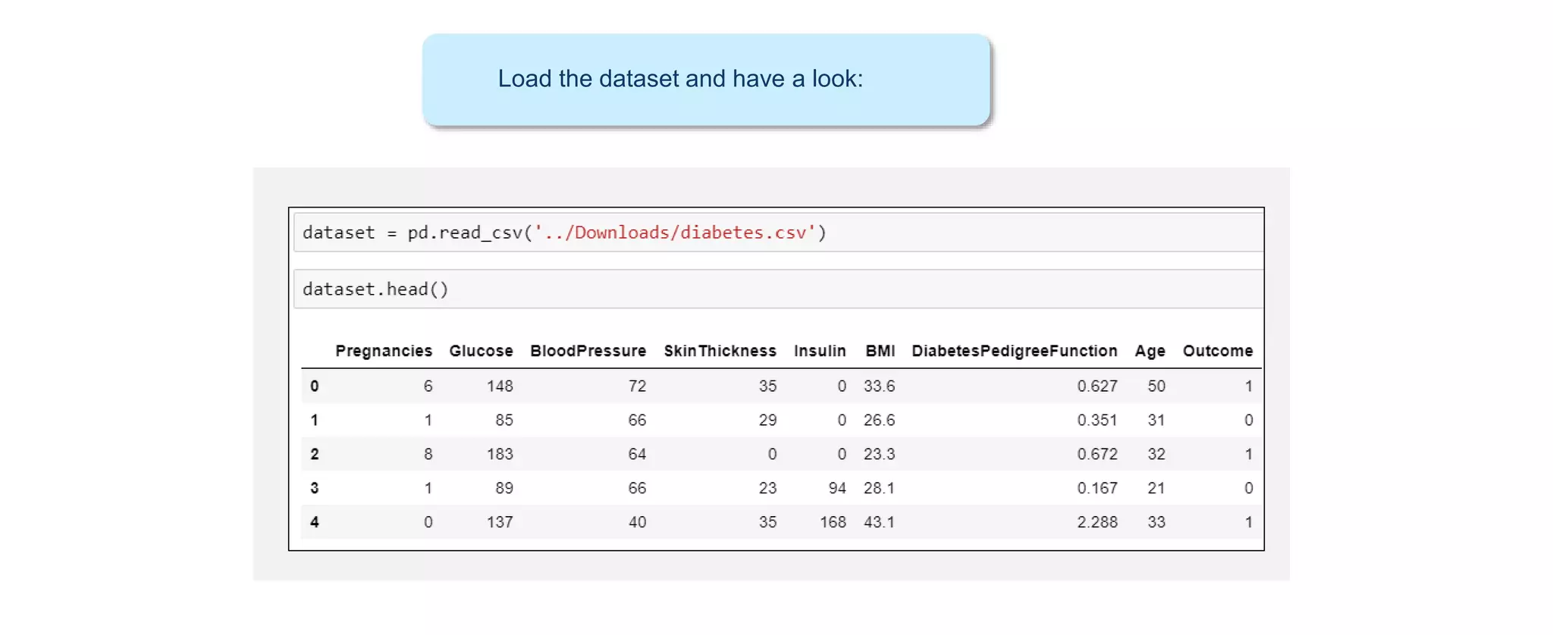

Slide 51
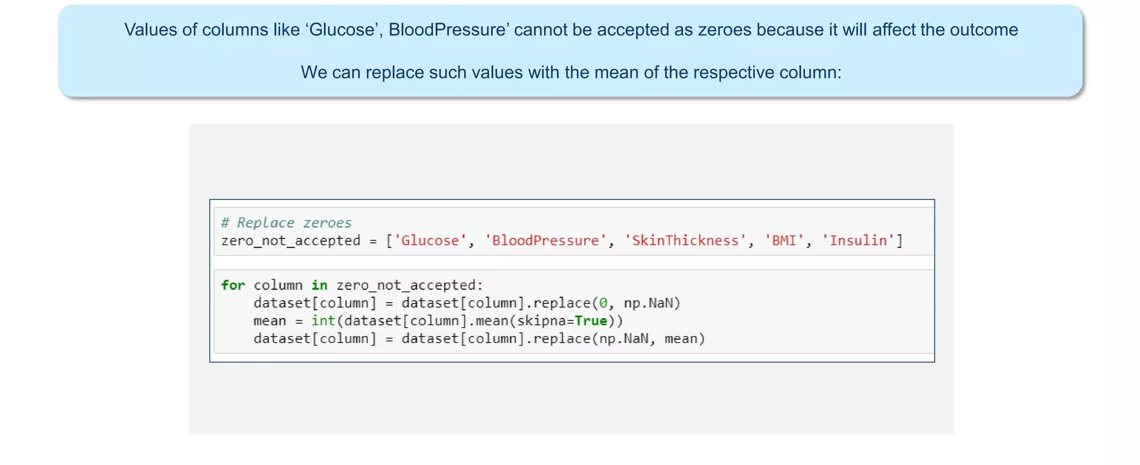

Slide 52
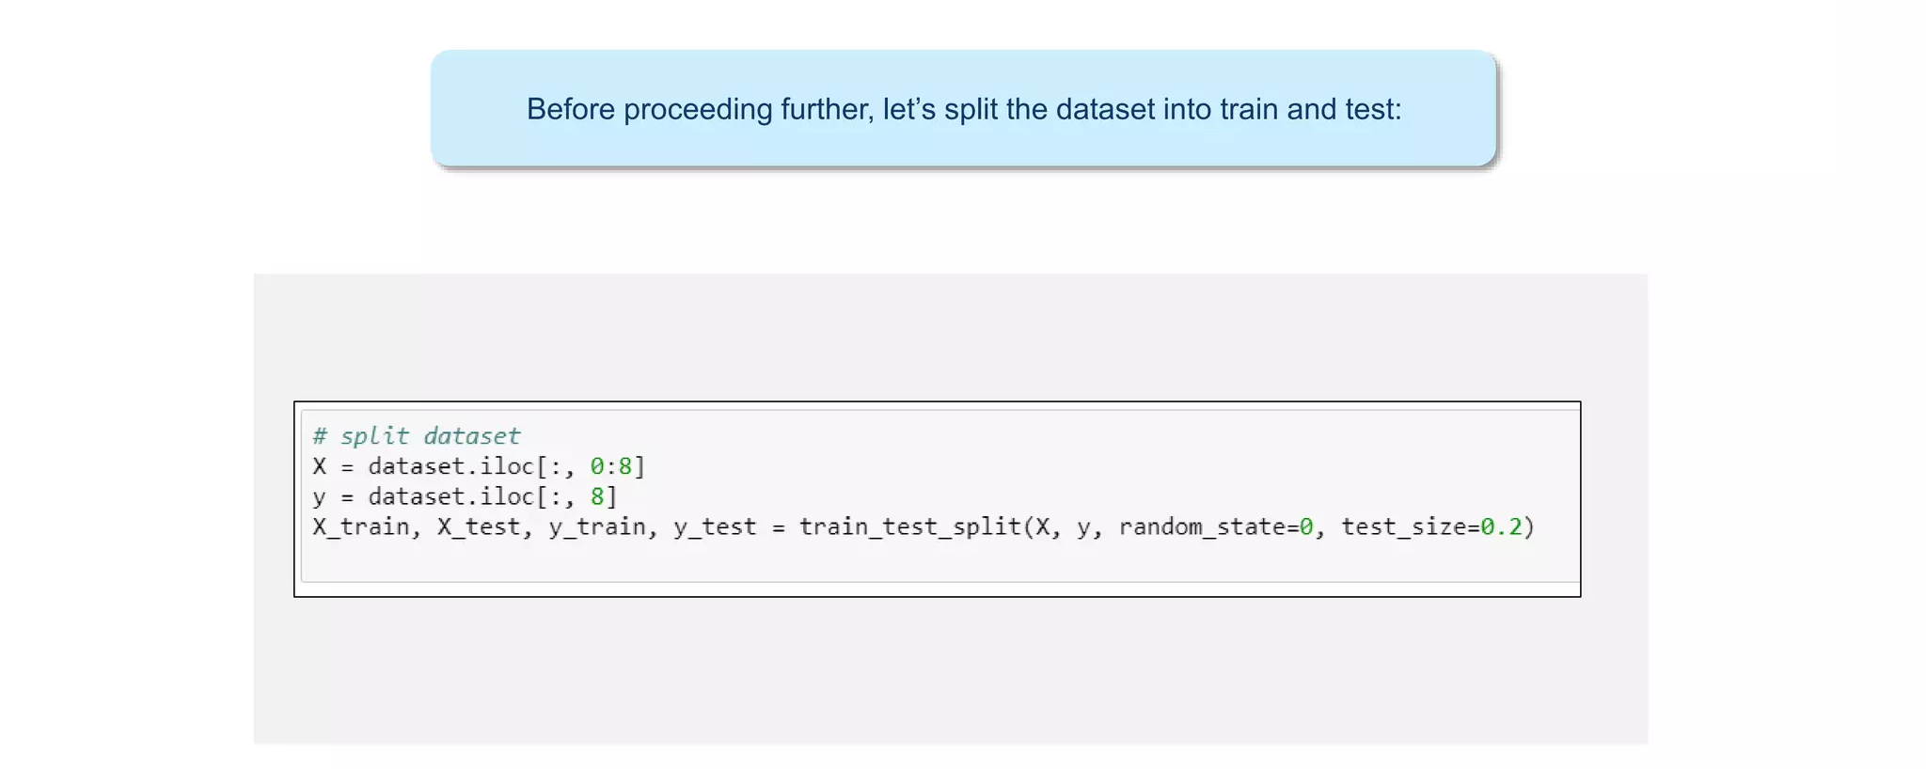

Slide 53
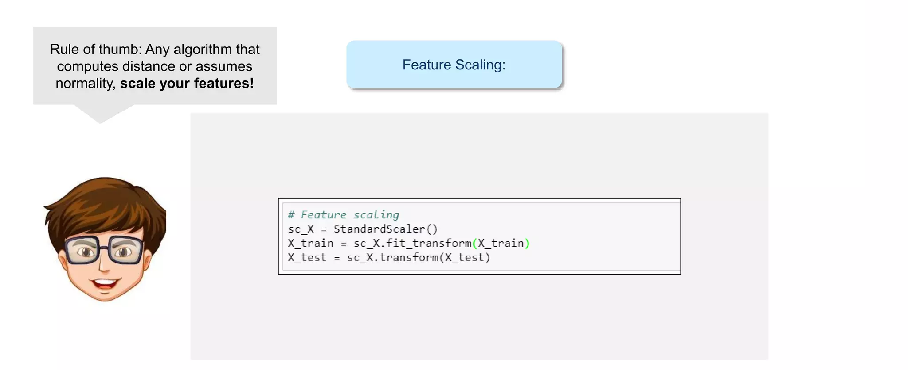

Slide 54
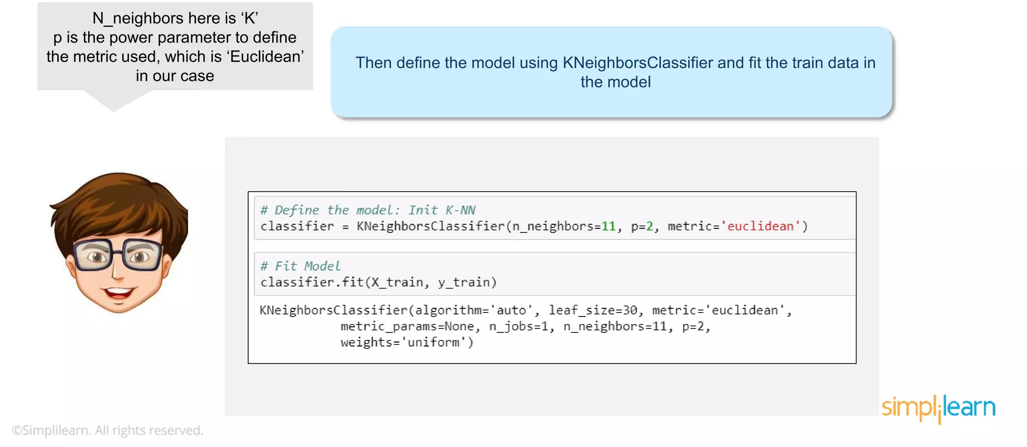

Slide 55
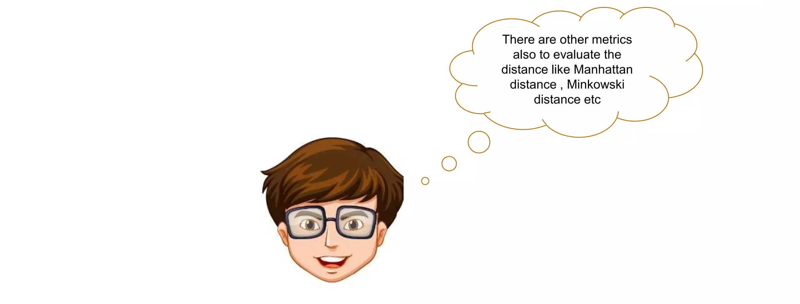

Slide 56
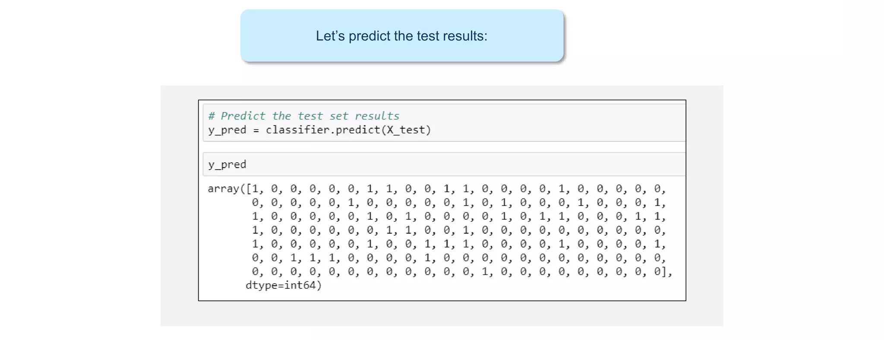

Slide 57
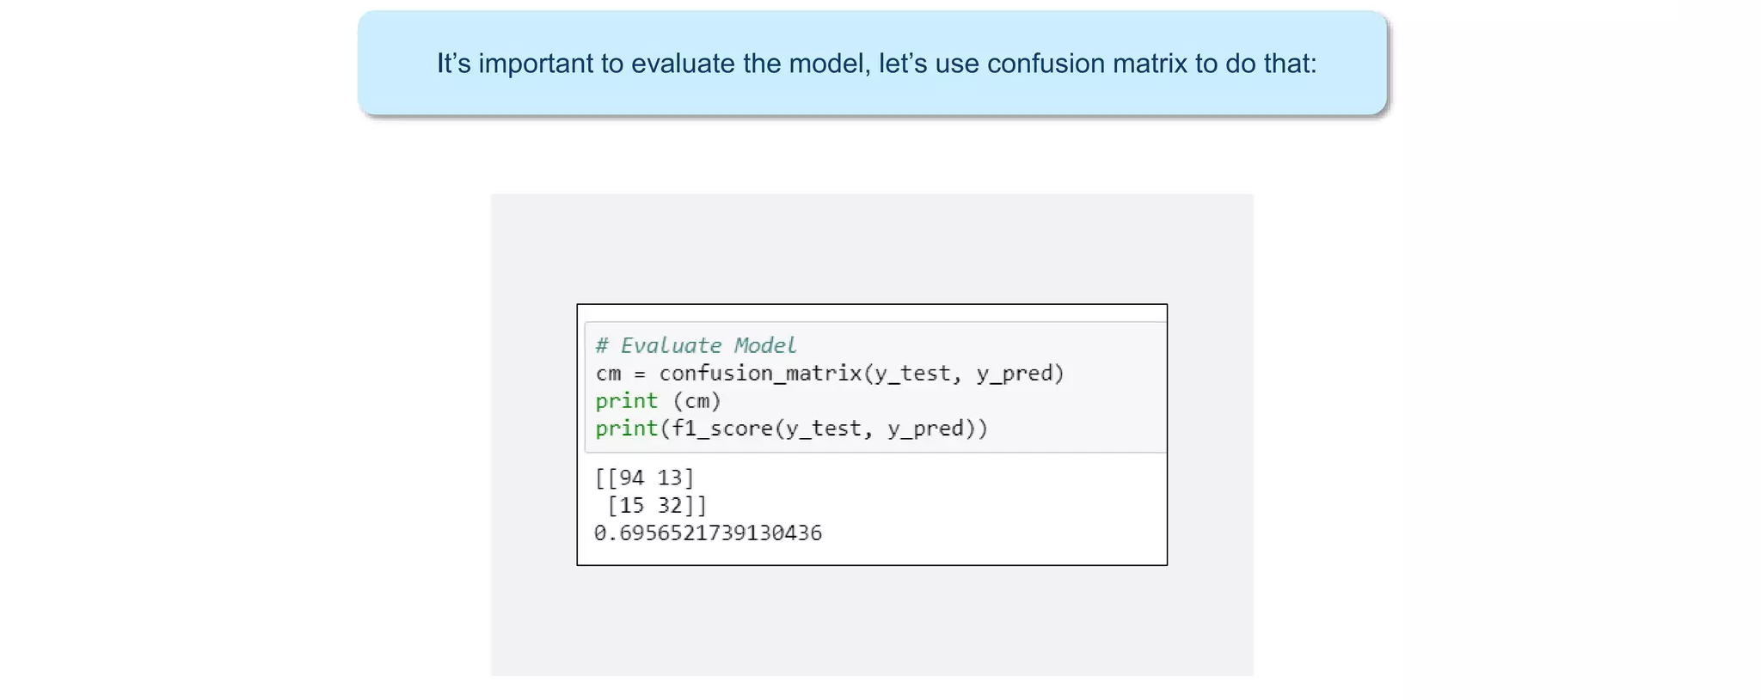

Slide 58
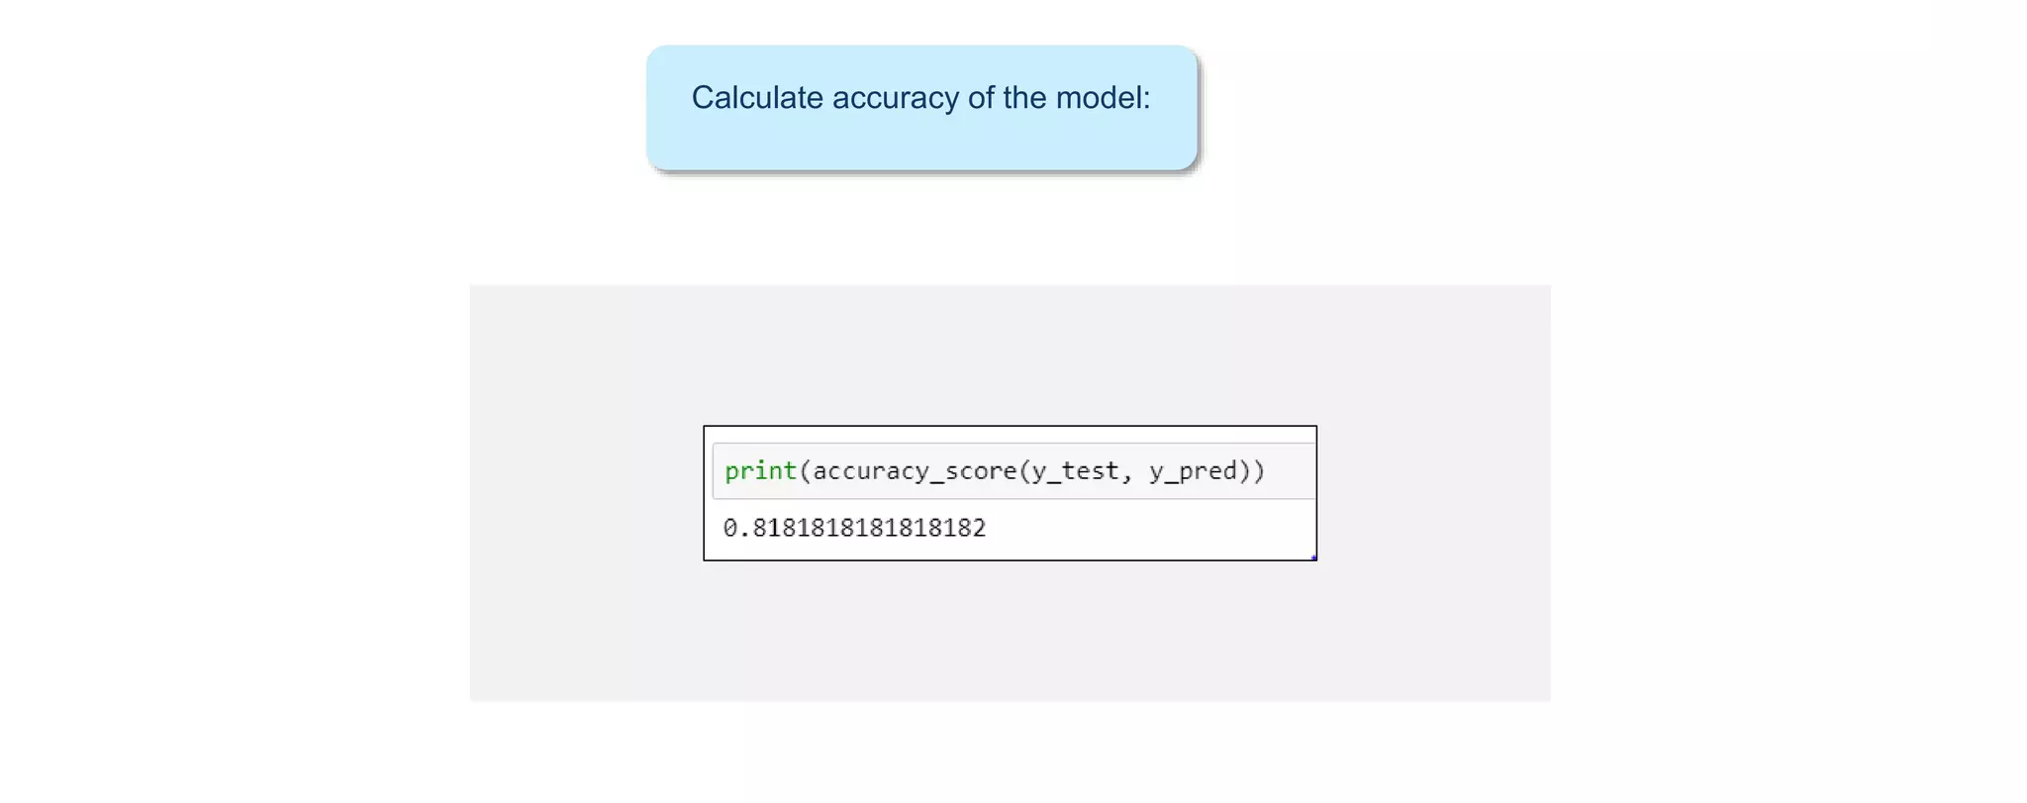

Slide 59
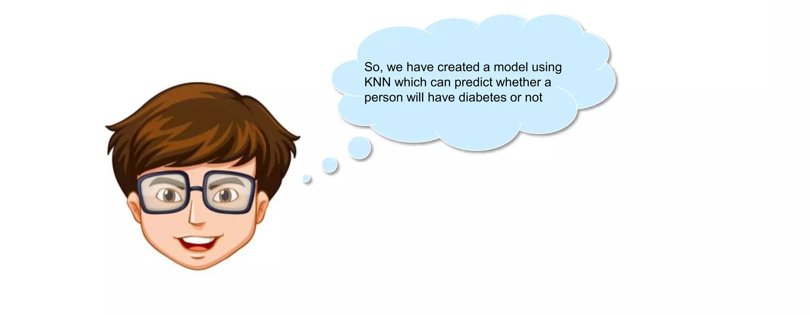

Slide 60
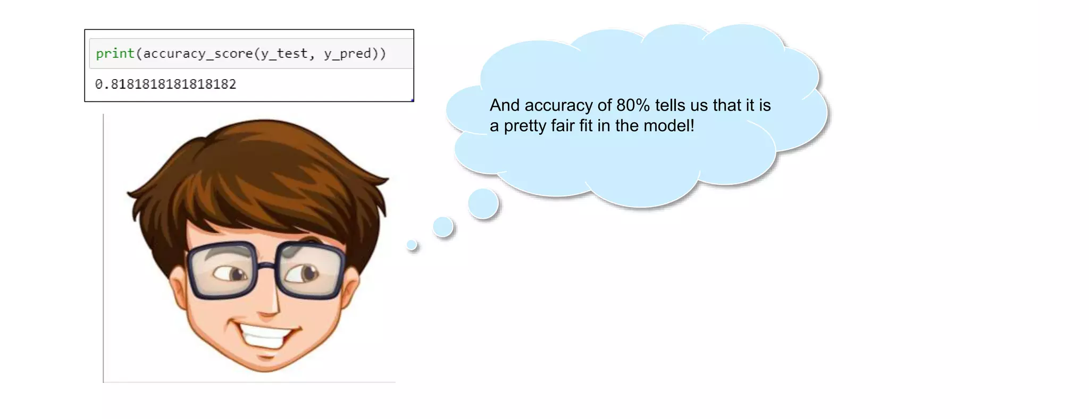

Slide 61
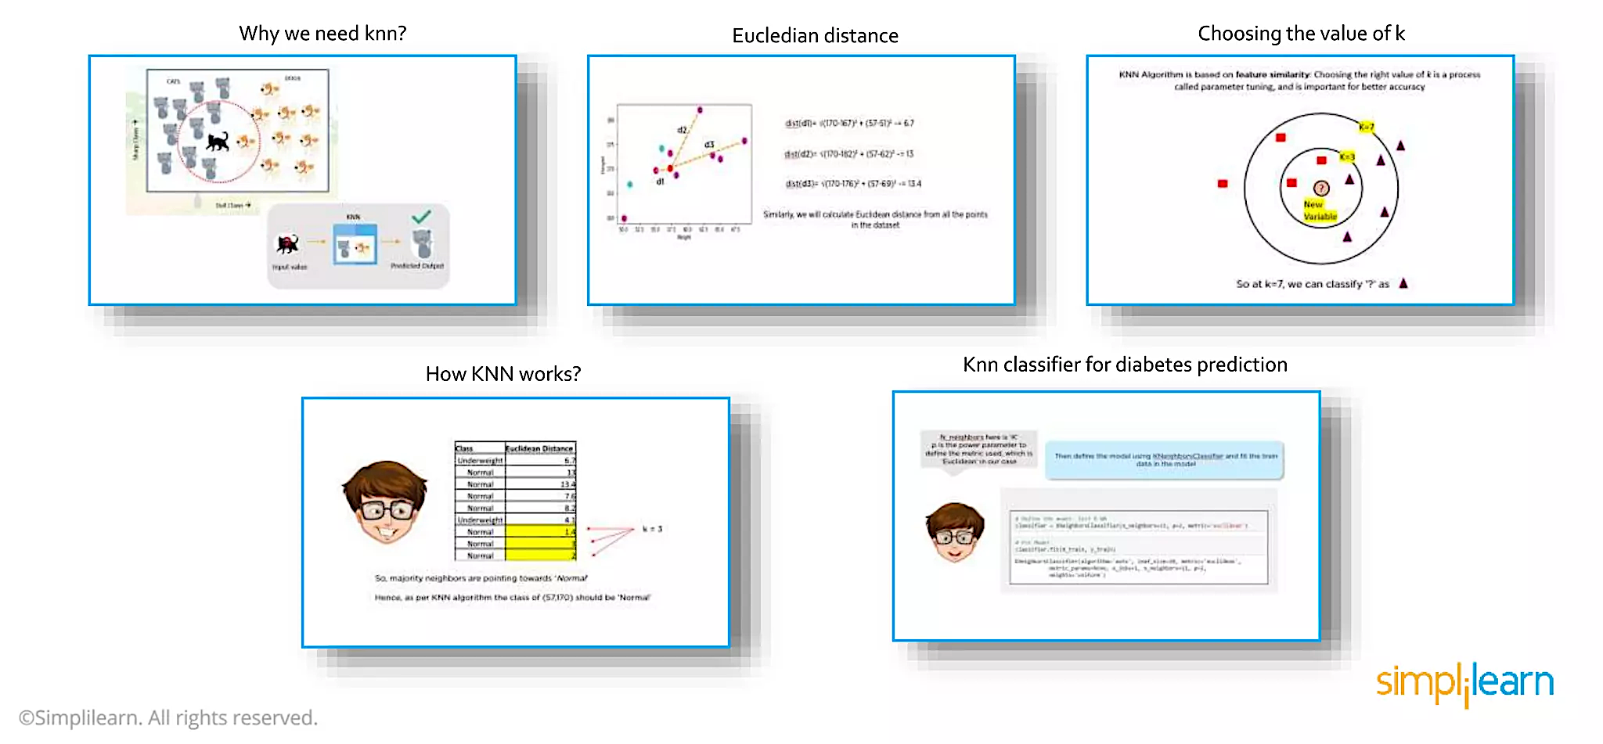
CCMACLRL

Slide 62
References
https://www.simplilearn.com/tutorials/machine-learning-tutorial/knn-in-python

